Slide 1

HOUSING PRICE PREDICTION
Group 9
Khúc Ngọc Nam : 20230086
Lê Trung Dũng : 20235489
Nguyễn Vương Trung Hiếu : 20235496
Nguyễn Hải Dương : 20235492
Thành Hựu Đạt : 20235909

Slide 2

AGENDA
Outline:
+ Executive Summary
+ Introduction
+ Preprocessing the Data
+ Models
+ Comparison between models

Slide 3

Execute summary
+ We collected the data from Kaggle, we will be working with a dataset based on [housing prices in Ames, Iowa] (House Prices - Advanced Regression Techniques | Kaggle). It was complied for educational use to be a modernized and expanded alternative to the well-known Boston Housing dataset.
+ Machine learning models used in this project: Linear Regression, Ridge Regression, Decision Tree, Random Forest, Gradient Boosting Decision Tree, K-Nearest Neighbors.

Slide 4

introduction
The housing price prediction problem involves developing a model to estimate the price of a house based on key features such as location, size, number of bedrooms, and other relevant factors. This problem combines elements of data preprocessing, feature engineering, and predictive modeling to understand market trends and provide accurate pricing estimates for decision-making in real estate.

Slide 5
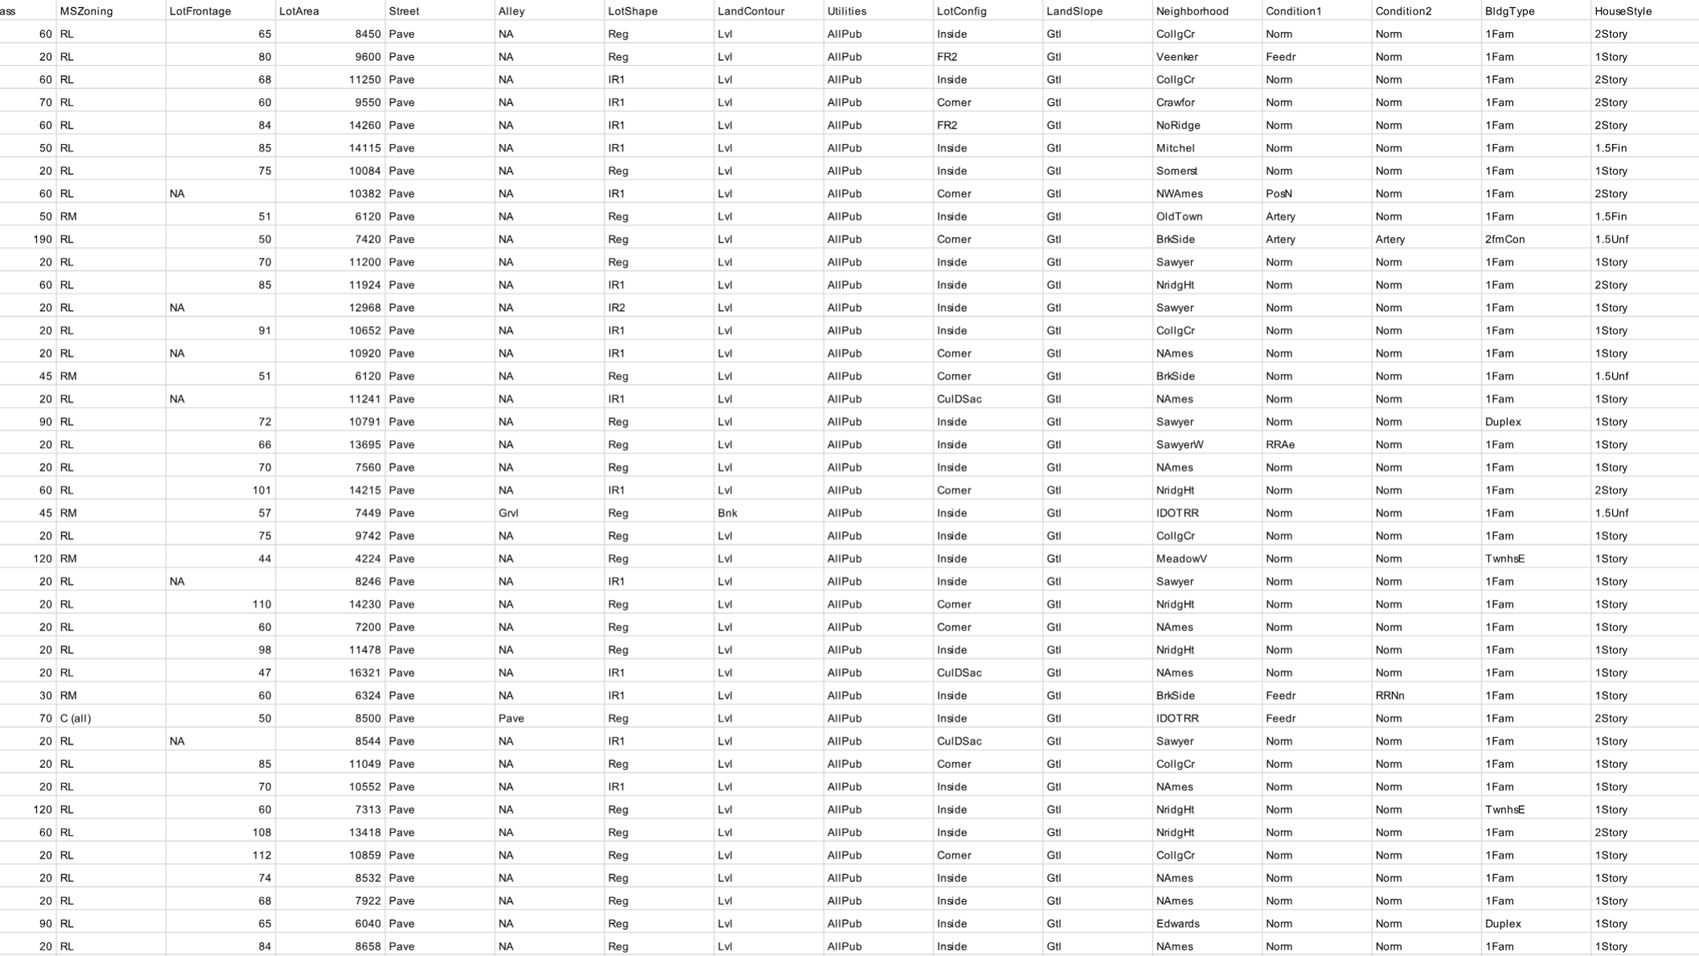
Dataset used in the project
+ train.csv (House Prices - Advanced Regression Techniques | Kaggle)
+ Test.Csv (House Prices - Advanced Regression Techniques | Kaggle)

Slide 6
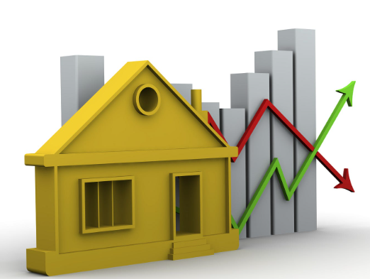
Exploratory data analysis

Slide 7
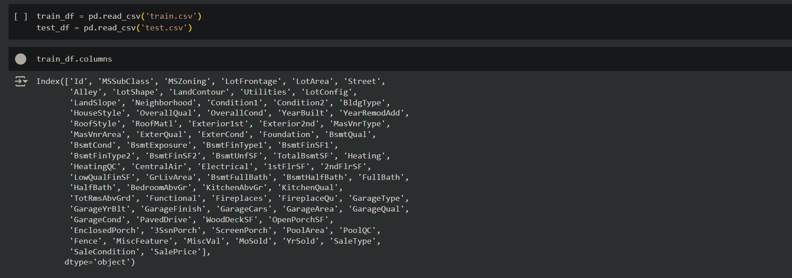
Find column name of the training dataset

Slide 8
1. Data Cleaning
Some methods we used to clean the dataset

Slide 9
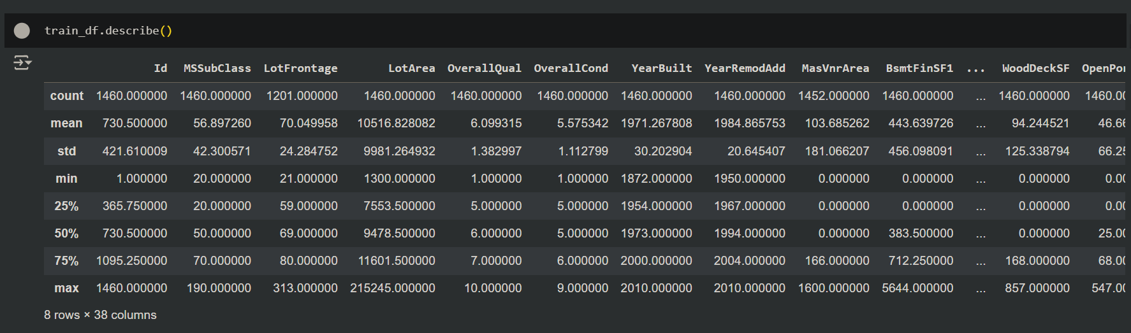
Describe the training dataset

Slide 10
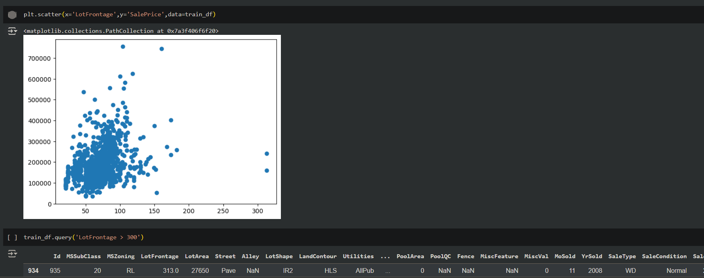
Detect and deal with noise for numerical features

Slide 11
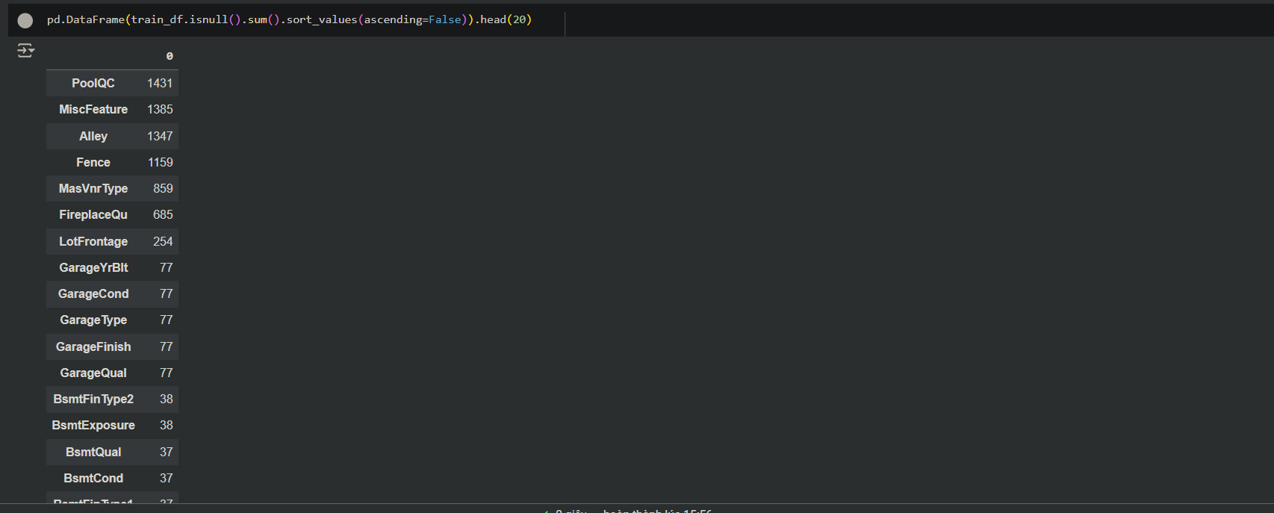
Identify and handle missing data

Slide 12
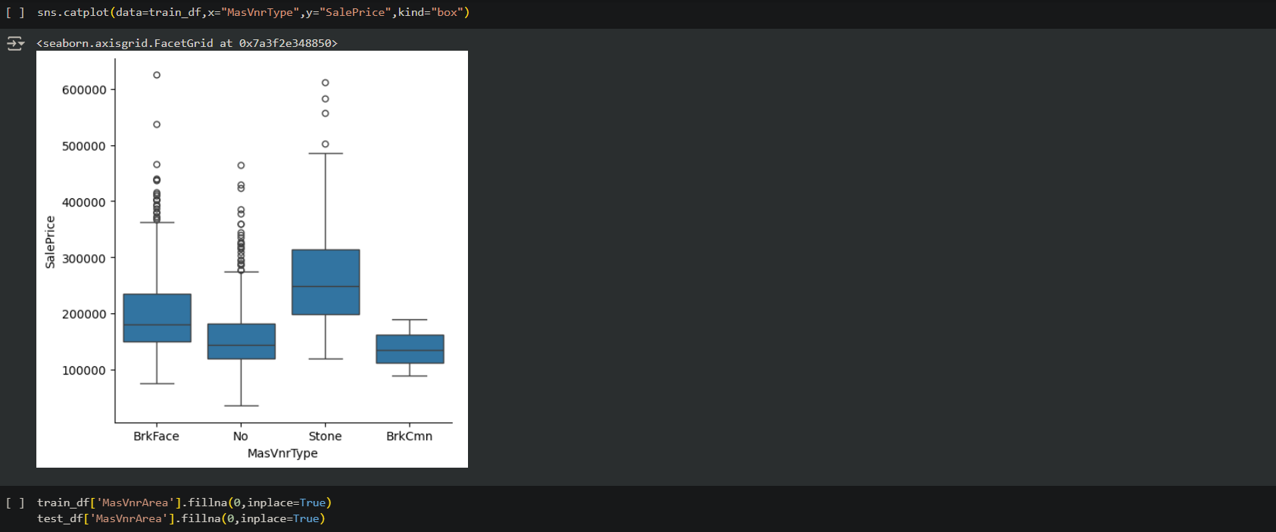
Detect and deal with noise for categorical features

Slide 13
2. Remodel the dataset

Slide 14
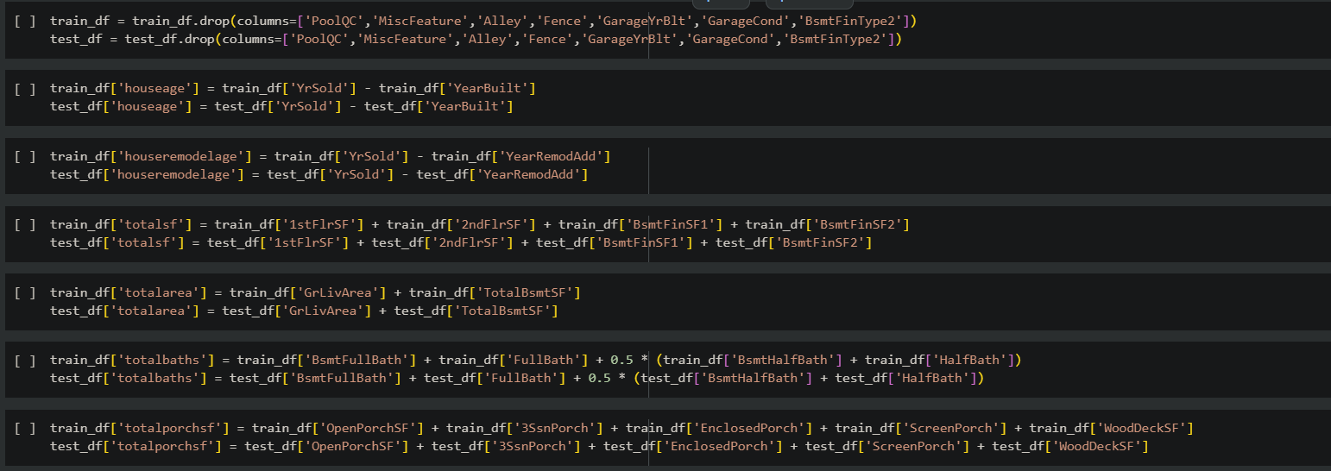
Replace some columns by the relation of other columns

Slide 15
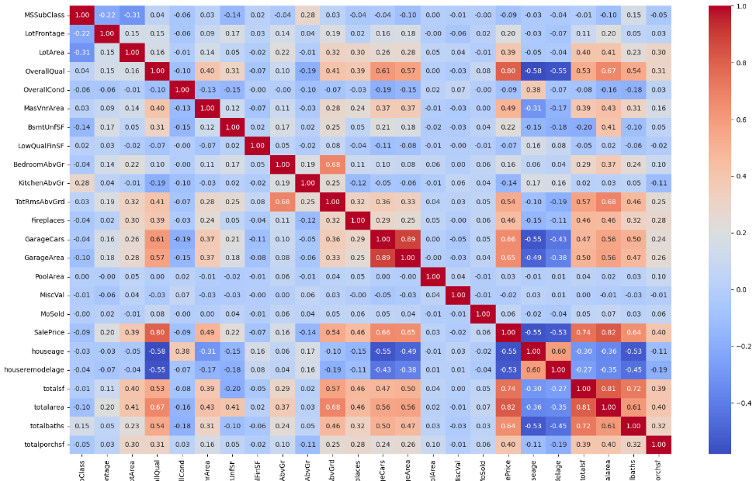
Use correlation matrix to show the correlation between the features and the label

Slide 16
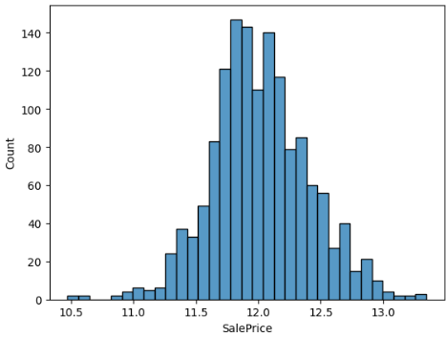
Distribution of housing price using normal distribution

Slide 17
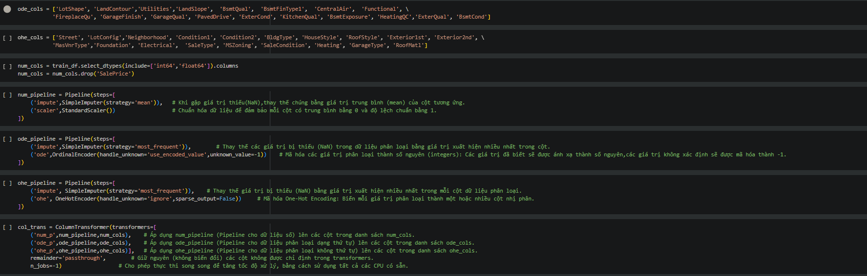
Classify the column for one-hot encoder and ordinal encoder

Slide 18
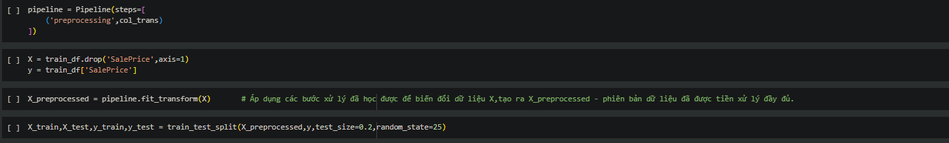
Preprocessing the dataset and get ready to train the model

Slide 19
Models used in the project

Slide 20
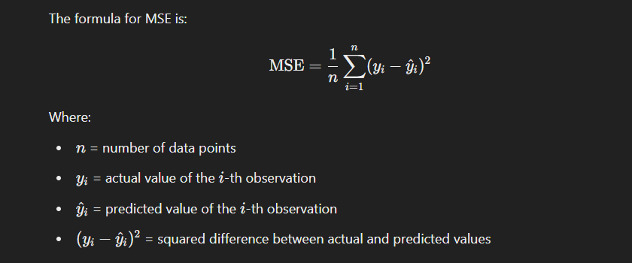
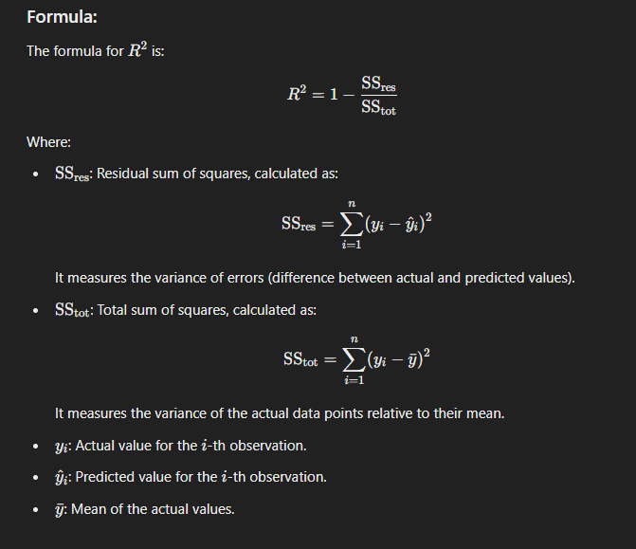
EVALUATING model performance
Mean squared error
(lOWER IS BETTER)
R_2 score
(HIGHER IS BETTER)

Slide 21
Regression model
Overview
Objective: Develop a model to predict house prices using relevant input factors.
Data:
For model testing: Use datasets provided in the sklearn library.
For model evaluation: Leverage the dataset previously introduced for performance assessment.
Goal: Identify and model the linear relationship between independent variables (features) and the dependent variable (house prices).

Slide 22
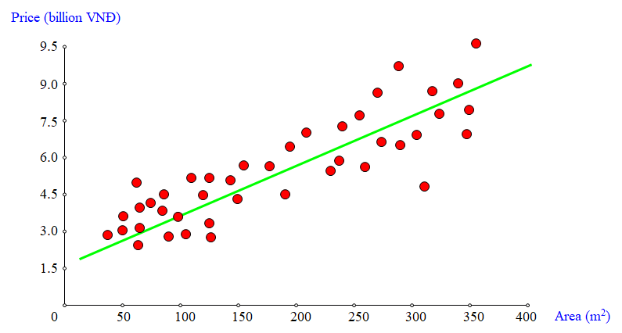
Regression model
Example
This graph describes the Linear relationship between Area and Price.

Slide 23
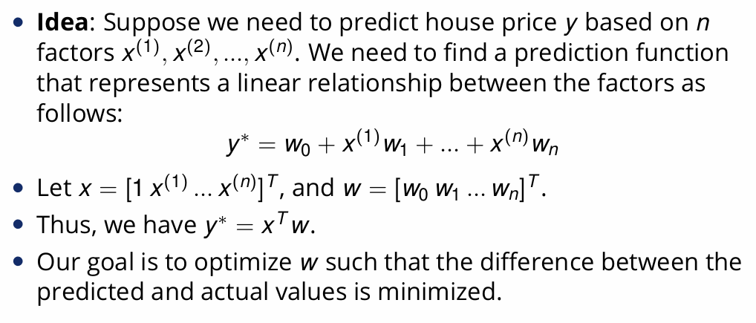
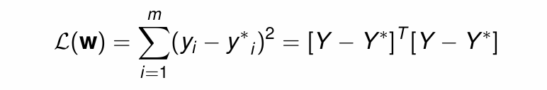
Linear regression
Objective: Minimize MSE Loss funtion:

Slide 24
Linear regression
Solutions for Optimizing the Loss Function in Linear Regression:
Approach 1: Directly compute the regression coefficients using the given data via the closed-form solution.
Approach 2: Use Gradient Descent to iteratively optimize the regression coefficients through continuous updates.

Slide 25
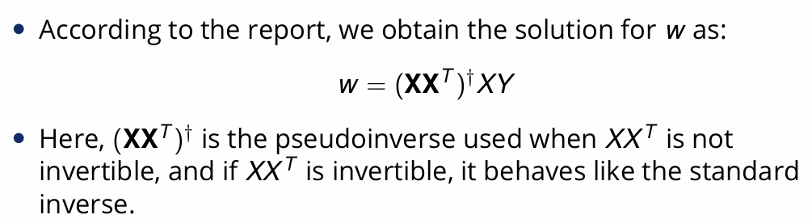
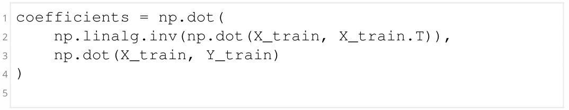
Linear regression
Approach 1: Direct Computation
Description: Employ the closed-form solution to directly calculate regression coefficients from the input data.
Code this formula by Python

Slide 26
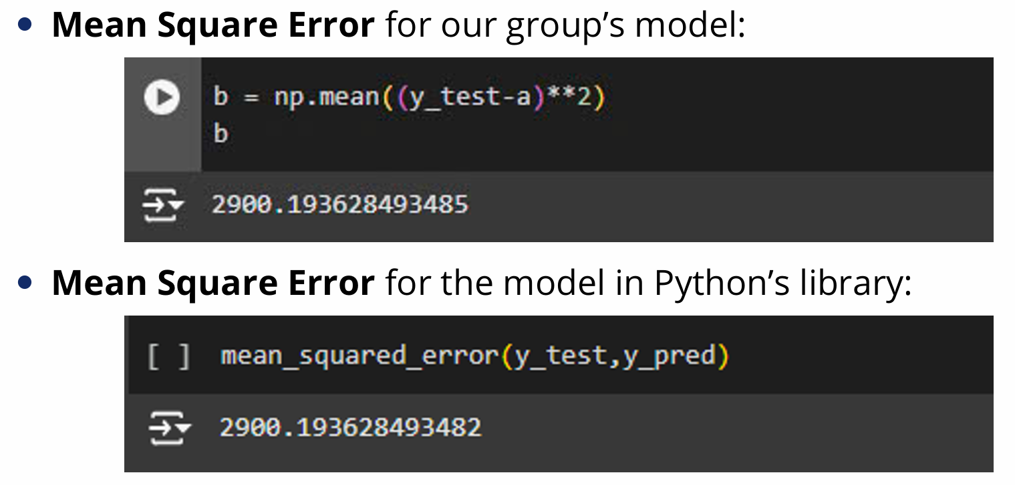
Linear regression
Approach 1: Direct Computation
MSE with sklearn’s built-in dataset

Slide 27
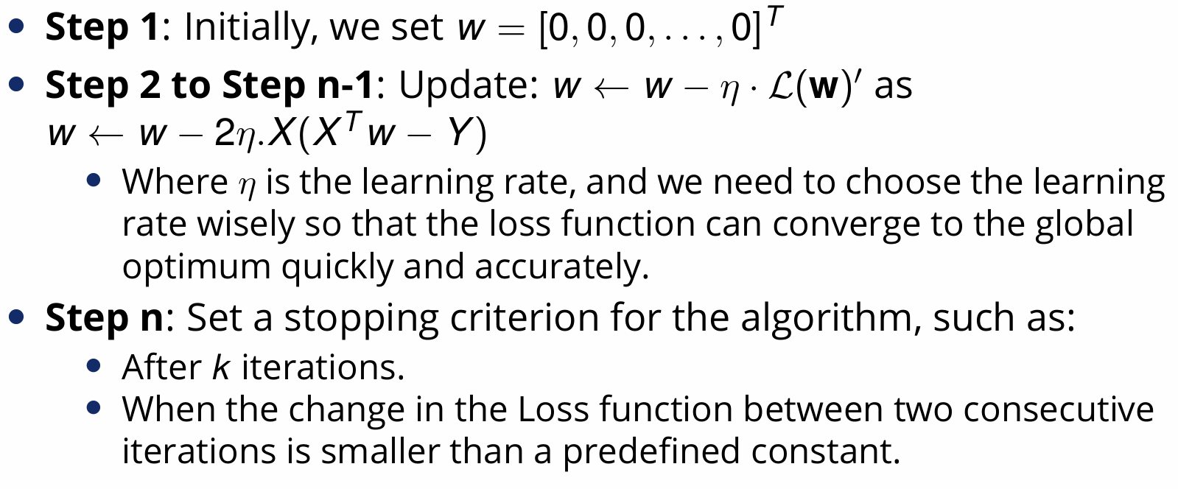
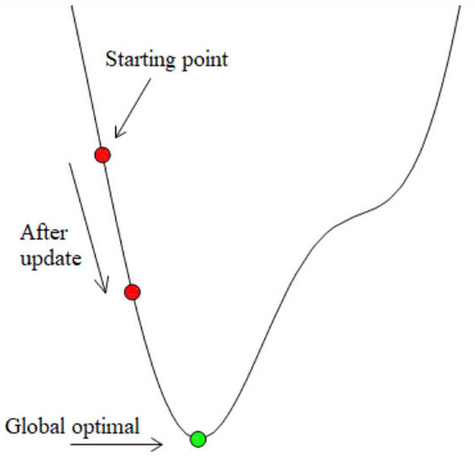
Linear regression
How to perform
Approach 2: Updating Regression Coefficients via Gradient Descent
Description: Use the Gradient Descent algorithm to optimize the loss function by iteratively updating the regression coefficients.

Slide 28
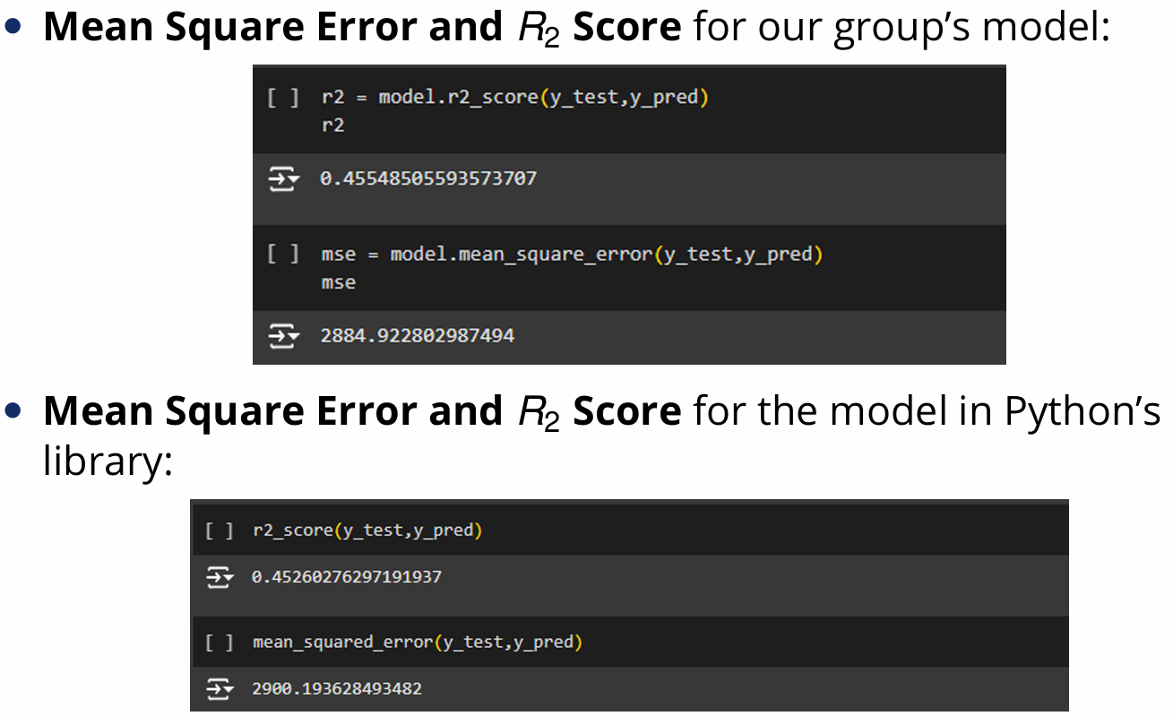
Linear regression
MSE with sklearn’s built-in dataset
Approach 2: Updating Regression Coefficients via Gradient Descent
Description: Use the Gradient Descent algorithm to optimize the loss function by iteratively updating the regression coefficients.

Slide 29
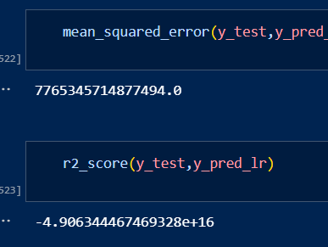
Results with Our Dataset

Slide 30
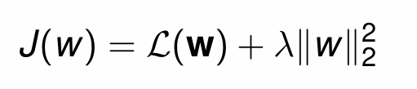
Ridge regression
IDEA
Introduce a regularization term λ in the loss function to control the magnitude of regression coefficients.
​
This helps mitigate overfitting by constraining the size of coefficients, especially in datasets with high variability or numerous independent variables.

Slide 31
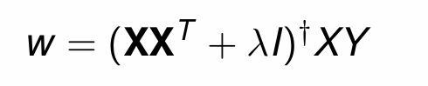
ridge regression
Approach 1: Direct Computation
Similar to the calculation of w in Linear Regression, derive the result.
Approach 2: Updating Regression Coefficients via Gradient Descent
We update:

Slide 32
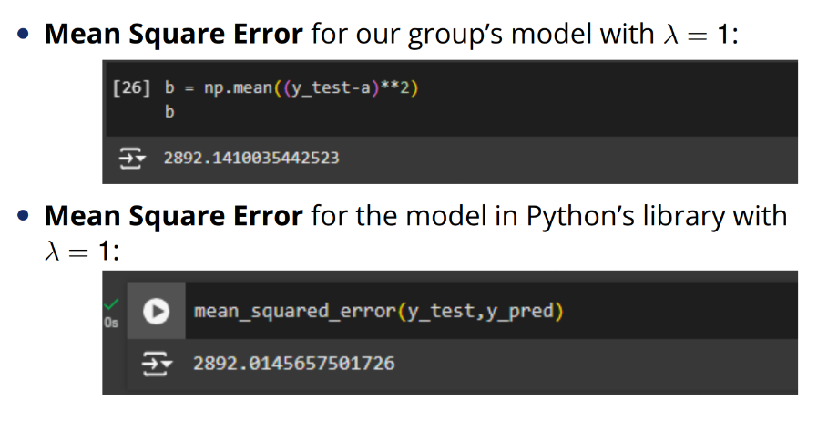
ridge regression
Approach 1: Direct Computation
MSE with sklearn’s built-in dataset

Slide 33
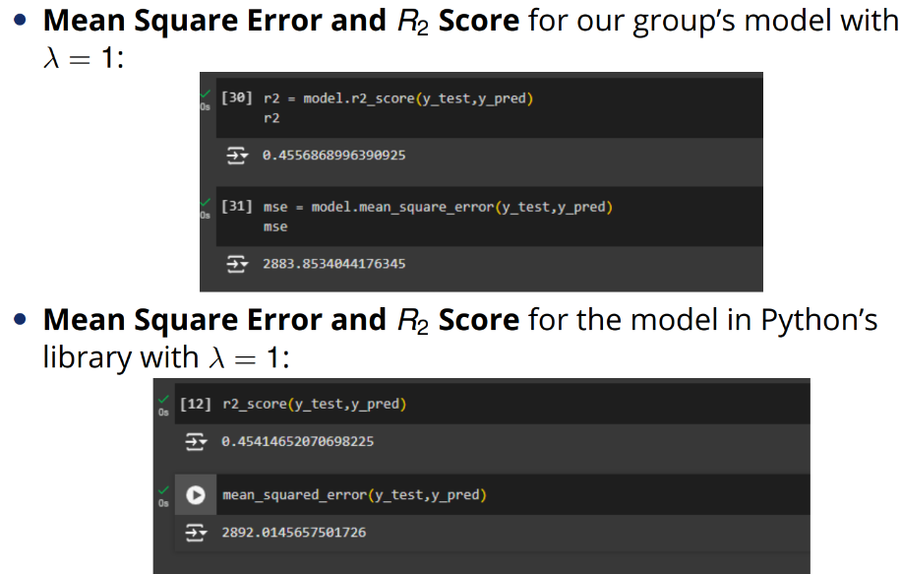
ridge regression
Approach 2: Updating Regression Coefficients via Gradient Descent
MSE with sklearn’s built-in dataset

Slide 34
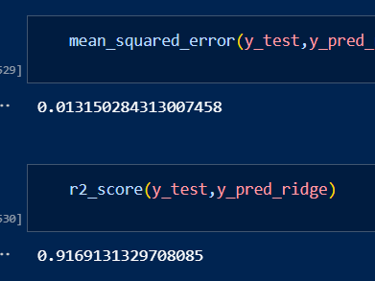
Results with Our Dataset

Slide 35
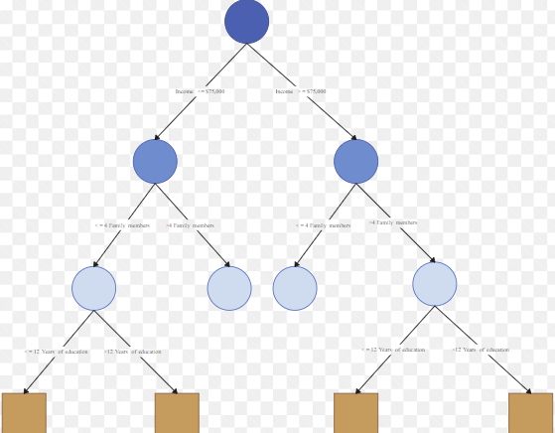
Decision Tree

Slide 36
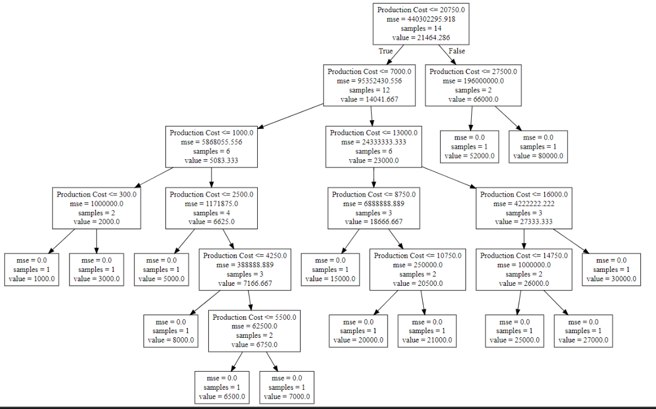
+ A decision tree is a model composed of a collection of “questions” organized hierarchically in the shape of a tree. + Each non-leaf node contains a condition, and each leaf node contains a prediction +The main idea of using a Decision Tree is to create a model that predicts the target variable by learning simple decision rules inferred from the data's features

Slide 37
+ Advantages:
Fast enough to train using hyperparameter tuning with cross-validation
Simple to visualize and interpret the logic and rules behind the prediction
Work well with missing data
Can be used with both classification and regression

Slide 38
+ Drawbacks
Tend to overfitting if not pruning carefully
Limited predictive power
Instability with noise

Slide 39
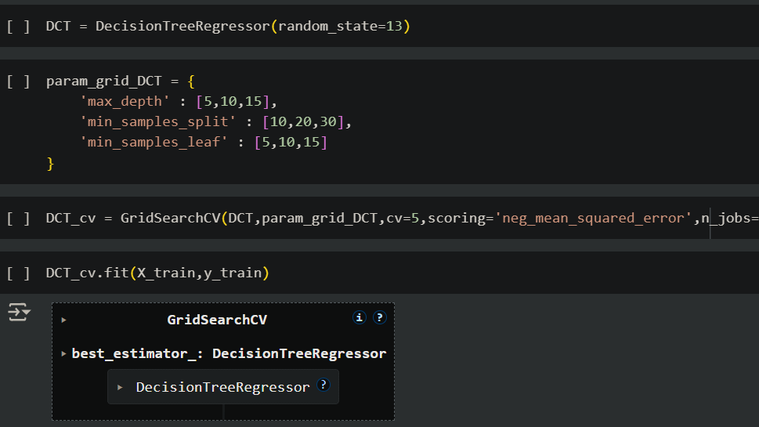
Implementing Decision tree

Slide 40
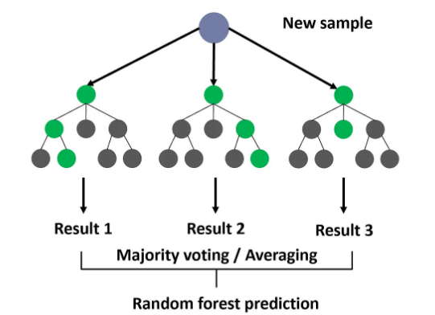
Random Forest

Slide 41
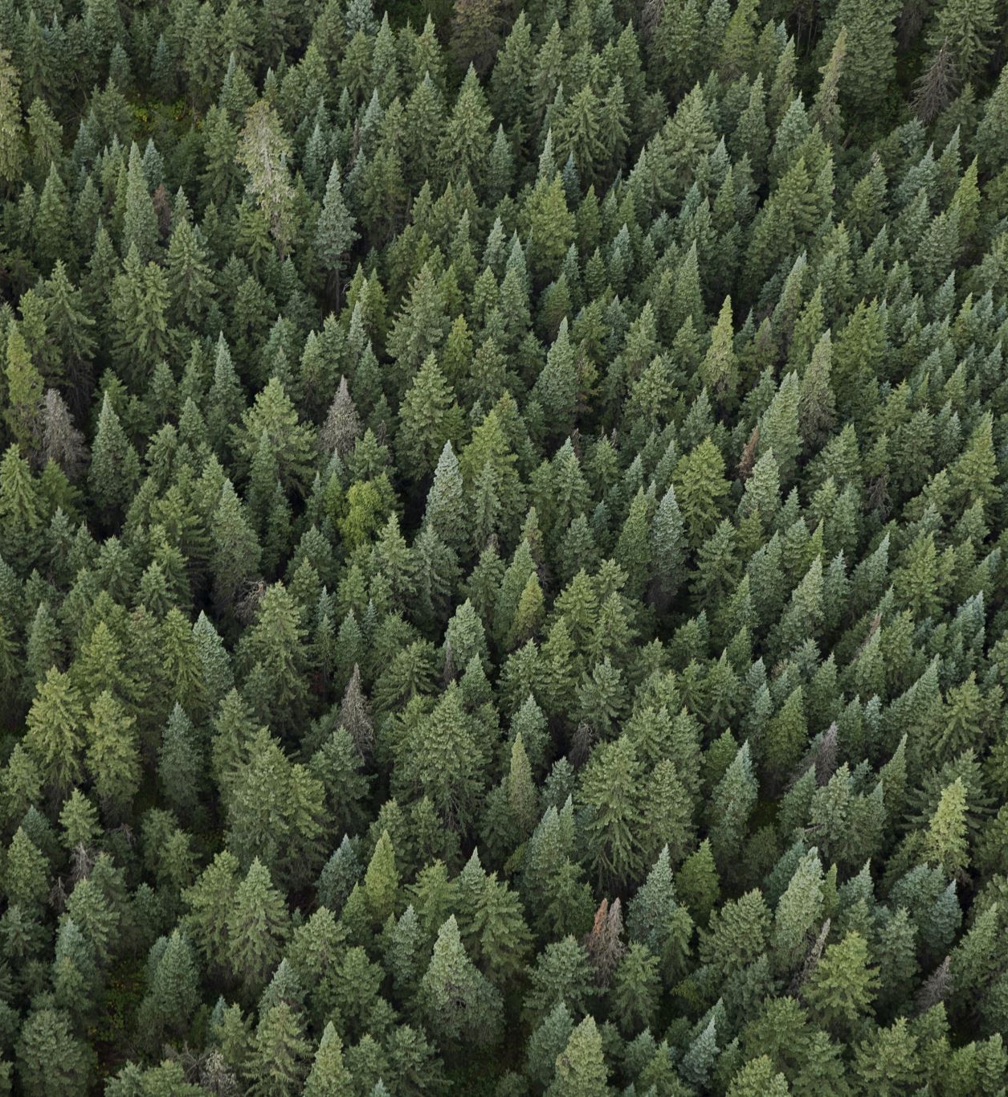
+ A random forest is an ensemble of decision trees in which each decision tree is trained with a specific random noise + The main idea of using Random Forest is to combine multiple decision trees to create a more robust, accurate, and stable predictive model

Slide 42
Example of random forest

Slide 43
+Advantages
Reduce overfitting (compare to decision tree)
Handle with large datasets
Work well with datasets that have complex relationships
Handle both classification and regression tasks effectively

Slide 44
+ drawbacks
Struggle with imbalanced dataset
Not suitable for Real-Time Predictions
Require a lot of computational resources and memory

Slide 45
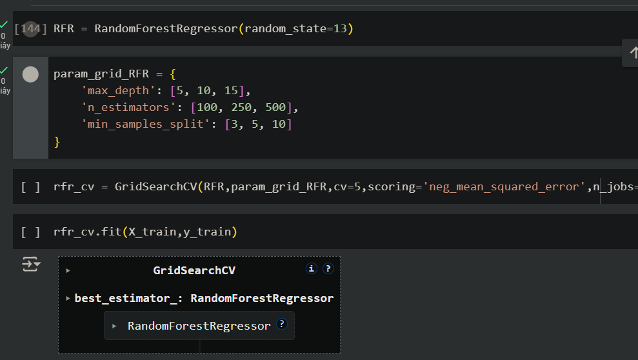
Implementing random forest

Slide 46
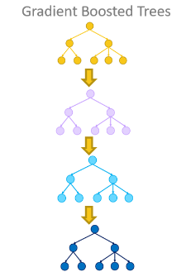
Gradient boosted decision tree

Slide 47
1. Gradient boosting
Gradient boosting is a methodology applied on top of another machine learning algorithms.
Involves two types of models:
+ “weak” machine learning model (Decision Tree)
+ “Strong” machine learning model (multiple weak models)
* At each step, a new weak model is trained to predict the “error” of the current strong model

Slide 48
2. XGboost
XGBoost (extreme gradient boosting) is a scalable, distributed gradient-boosted decision tree machine learning library.
Provide parallel tree boosting and is the leading machine learning library for regression, and classification.

Slide 49
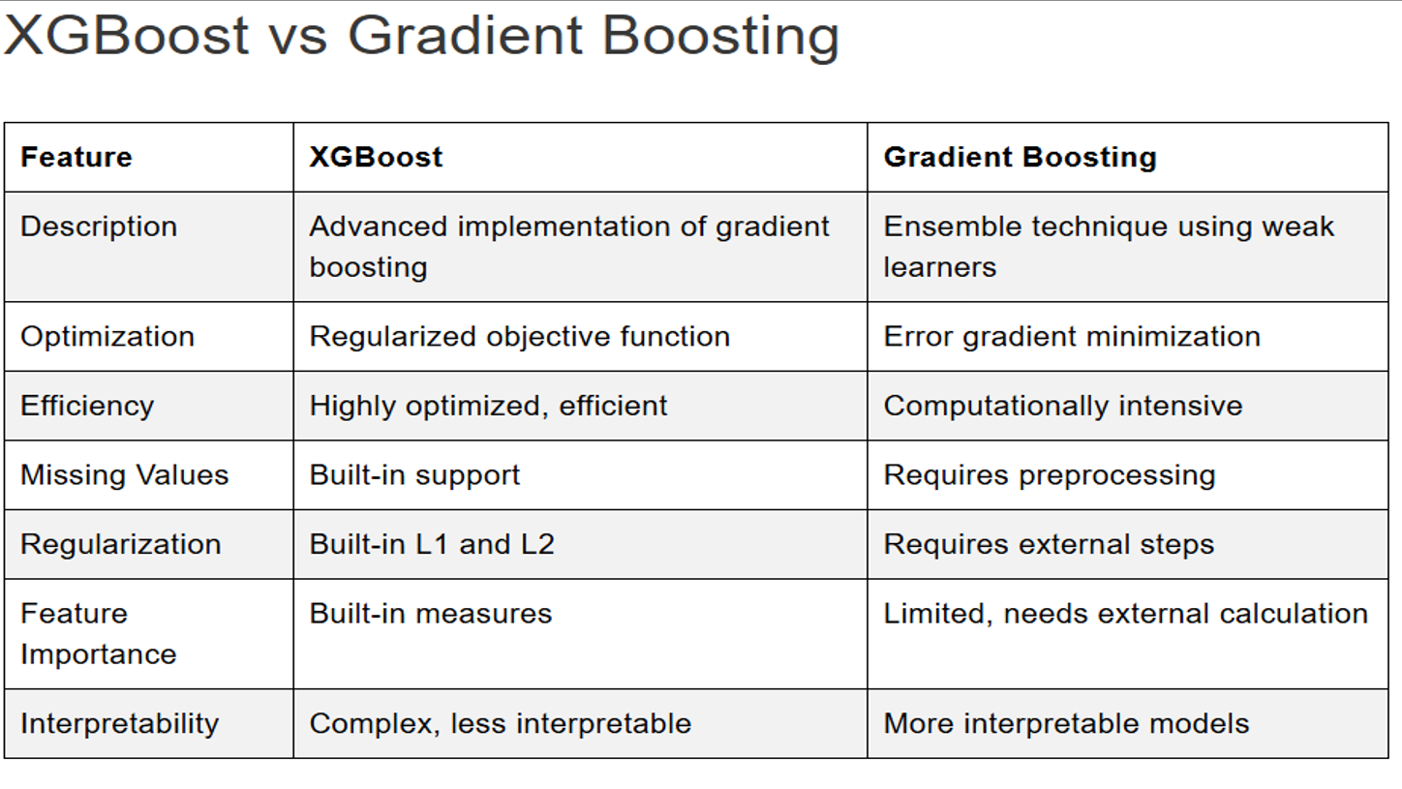

Slide 50
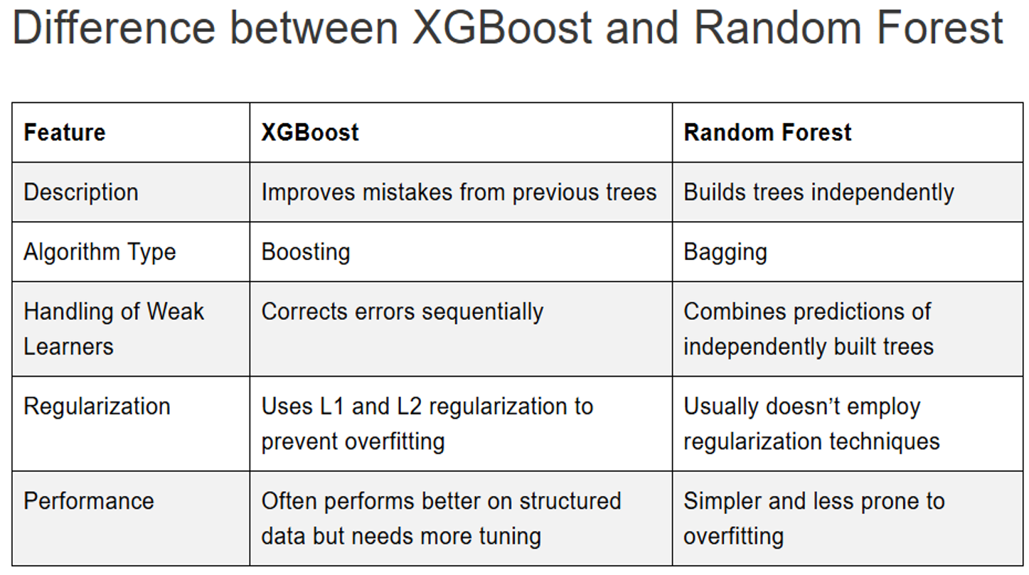

Slide 51
+ Advantages
Superior predictive performance
Built-in regulARIzation techniques
versatility

Slide 52
+ drawbacks
time-consuming (especially with large datasets)
Prone to overfitting
Depend on careful tuning of hyperparameters
Less resilient to outliers

Slide 53
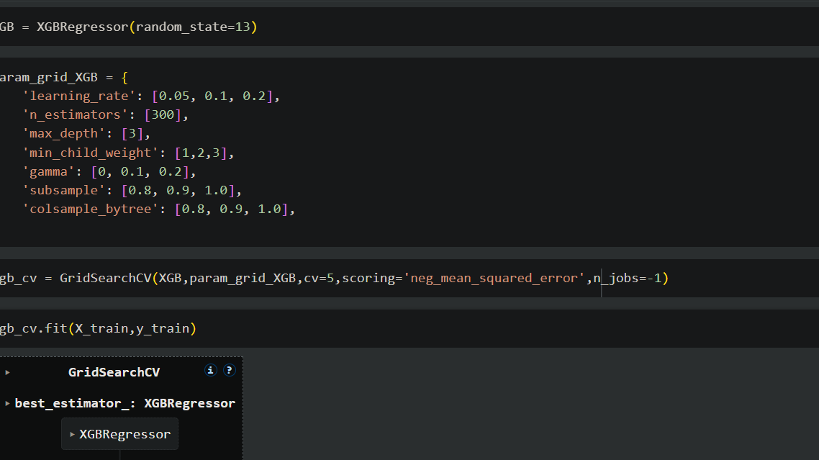
Implementing xgboost

Slide 54
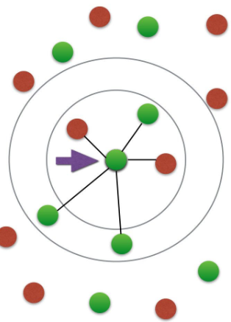
k-nearest neighbors

Slide 55
K-Nearest neighbors (knn) is a non-parametric and supervised machine learning used for both classification and regression
The main idea is to predict the label or value of a data point based on the k nearest neighbors in the training dataset

Slide 56
+ advantages
Easy to understand and implement
Versatility
Not training required

Slide 57
+ drawbacks
Computational expensive (especially with large dataset)
Sensitive to noise
Depend on k
Inefficient with high dimensions

Slide 58
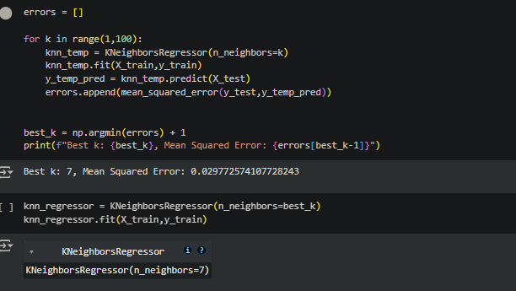
Implementing k-nearest neighbors

Slide 59
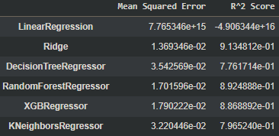
Model comparison

Slide 60
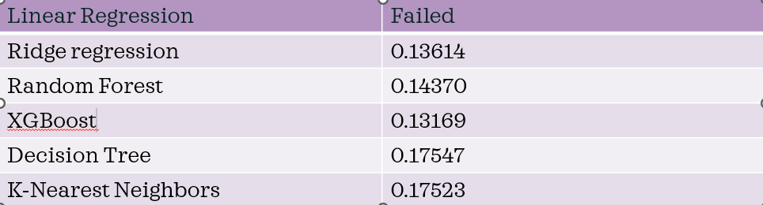
Score judged in Kaggle competition
The lower the score, the more accurate the model is.

Slide 61

conclusion

Slide 62
The models that performed the best are Gradient Boosted Decision Tree, Random Forest, and Ridge Regression
The model can assist investors, home buyers, and real estate companies in making sound data-based decisions.
Technical challenges:
+ The quality and richness of the data have a major impact on model results.
+ Algorithms can be affected by noise or unusual data patterns
Future research:
+ Expand the dataset with more detailed features to increase model accuracy
+ Apply deep learning models to exploit complex relationships between factors better.

Slide 63

THANK YOU For your attention!

